Slide 1



Q4 RESULTS &
OUTLOOK
GROWTH STRATEGIES 2024

Slide 2
Executive Summary
A strong finish to the fiscal year driven by core product resilience and strategic efficiency measures, setting a robust foundation for our aggressive 2024 expansion plan.

Slide 3


Key Financial Metrics Q4
15%
22%
$4.2M
Revenue Growth YoY
EBITDA Margin
Net Income

Slide 4
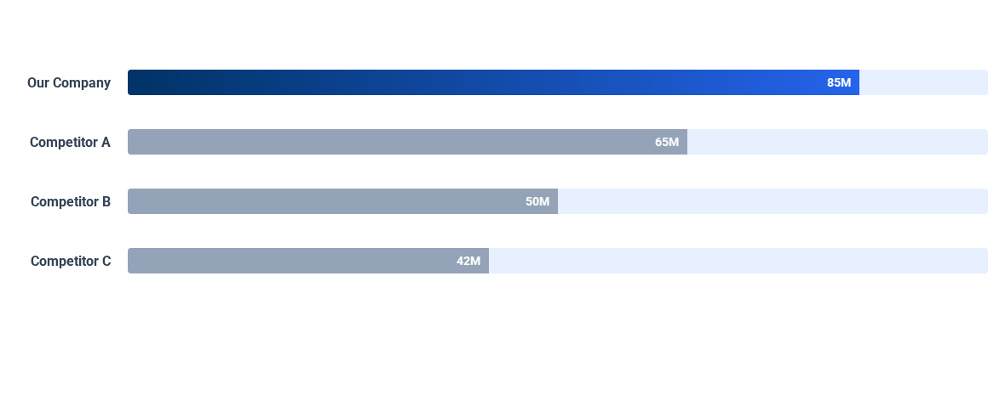
Revenue vs. Competitors (Q4)
We maintained a leading market position despite aggressive pricing from Competitor A.

Slide 5


Operational Highlights
Supply Chain Optimization
Product Gen 2 Launch
Successfully negotiated new logistics contracts, reducing average shipping costs by 10% while improving delivery times by 15% across North America.
The rollout of our second-generation flagship product exceeded initial sales targets by 20% in the first month, validating our R&D investment.

Slide 6
2024 Growth Strategies
Moving forward, our focus shifts to three core pillars designed to scale operations and capture emerging market opportunities.

Slide 7






Strategic Pillars for 2024
Innovation
Expansion
Efficiency
Doubling down on R&D to integrate AI-driven features into our core product suite.
Entering two new APAC markets in Q3 to diversify our revenue stream.
Automating backend workflows to improve operational margins by an estimated 5%.

Slide 8

Digital Transformation
We are investing heavily in a cloud-first infrastructure.
Migration of 90% of data to secure cloud servers by Q2.
Implementation of real-time analytics dashboards for all department heads.
Adoption of AI customer support tools to reduce response time.

Slide 9
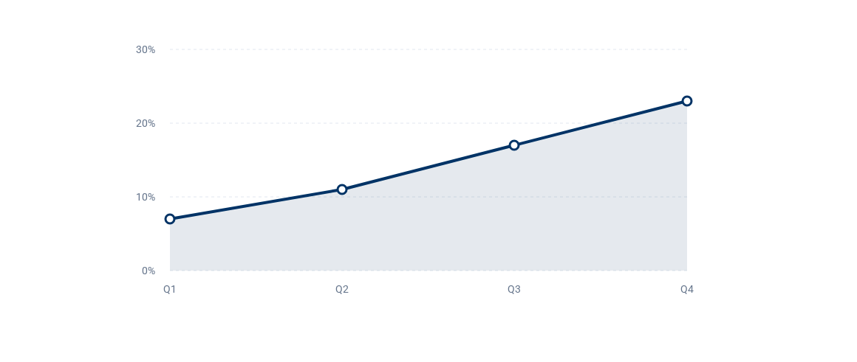
Market Share Trends (Last 4 Quarters)
Consistent growth in market share, reaching 23% by year-end.

Slide 10


Talent & Culture
Upskilling Initiative: Launching a company-wide certification program for data literacy.
Diversity & Inclusion: New hiring protocols implemented to ensure diverse candidate pools for all senior roles.
Retention Focus: Enhanced benefits package to be rolled out in Q1 to improve employee satisfaction and retention.

Slide 11




2024 Execution Roadmap
Q1: Planning
Q2: Launch
Q3: Expansion
Q4: Review
Finalize APAC entry strategy and launch internal upskilling.
Deploy cloud infrastructure and beta test AI features.
Official market entry into Singapore and Australia.
Assess market penetration and optimize operational workflows.

Slide 12
Q&A
Thank you for your attention.
investor.relations@company.com

Slide 13



Image Sources
https://plus.unsplash.com/premium_photo-1663011492084-4fe26a56d49f?fm=jpg&q=60&w=3000&ixlib=rb-4.1.0&ixid=M3wxMjA3fDB8MHxwaG90by1yZWxhdGVkfDE0fHx8ZW58MHx8fHx8
Source: unsplash.com
https://images.stockcake.com/public/4/a/9/4a9806a0-7586-4fde-bf67-209a190f2140_large/analytics-dashboard-display-stockcake.jpg
Source: stockcake.com
https://static.vecteezy.com/system/resources/previews/067/458/039/large_2x/a-diverse-team-collaborates-in-a-modern-office-setting-during-a-business-meeting-they-are-discussing-a-plan-photo.jpg
Source: www.vecteezy.com

